Slide 1
Lecture 3

Slide 2
OSI Security Architecture

Slide 3
OSI Security Architecture
International Telecommunication Union – Telecommunication (ITU-T) recommends X.800
Security Architecture for Open Systems Interconnection (OSI)
Defines a systematic way of defining and providing security requirements
Used by IT managers and vendors in their products
Security attacks
Security mechanisms
a process (or a device incorporating such a process) to detect, prevent, or recover from an attack
Security services
enhances the security of the data processing systems and the information transfers, such as policies

Slide 4
Other Security Architectures
OWASP - Open Web Application Security Project
web application security
OWASP foundation
NIST, Cybersecurity Framework
https://www.nist.gov/cyberframework
VIRTUAL WORKSHOP #2 | February 15, 2023 (9:00 AM – 5:30 PM EST). Join us to discuss potential significant updates to the CSF as outlined in the soon-to-be-released CSF Concept Paper.
https://www.nist.gov/news-events/events/2023/02/journey-nist-cybersecurity-framework-csf-20-workshop-2

Slide 5
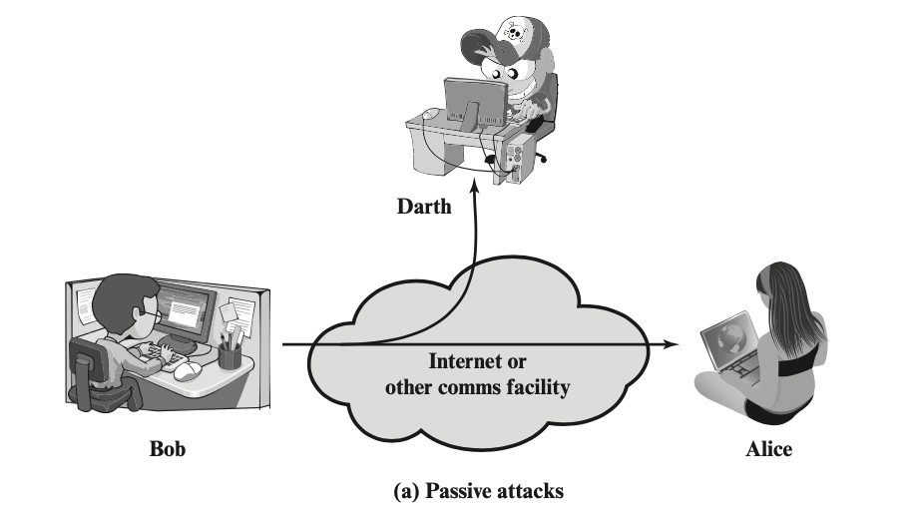
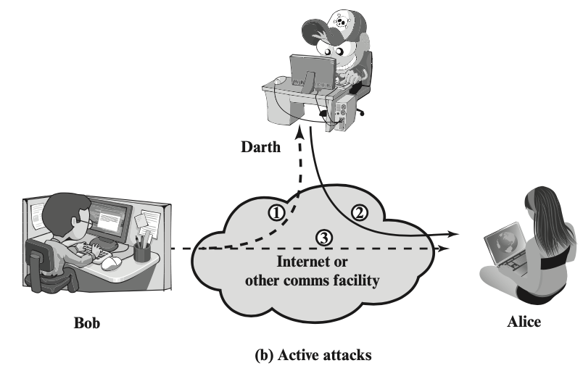
Security attack
Definition: any action that compromises the security of information owned by an organization
Two types of security attacks
Passive attack
Active attack

Slide 6
Passive attack
i.e. eavesdropping on or monitoring of transmissions
Goal: obtain information being transmitted
release of message contents
traffic analysis – a promiscuous sniffer
Very difficult to detect – no alteration of the data
But easy to prevent, why?

Slide 7
Active attack
active attack includes:
Masquerade
replay
Modification of messages
Denial of service

